Slide 1
Lecture 05: Assembly Language Programming (2)

Slide 2
The 80x86 IBM PC and Compatible Computers
Chapter 3
Arithmetic & Logic Instructions and Programs
Chapter 6
Signed Numbers, Strings, and Tables

Slide 3
Arithmetic Instructions
Addition
Subtraction
Multiplication
Division

Slide 4
Unsigned Addition
ADD dest, src ;dest = dest + src
  Dest can be a register or in memory
  Src can be a register, in memory or an immediate
  No mem-to-mem operations in 80X86
  Change ZF, SF, AF, CF, OF, PF
ADC dest, src ;dest = dest + src +CF
  For multi-byte numbers
  If there is a carry from last addition, adds 1 to the result

Slide 5
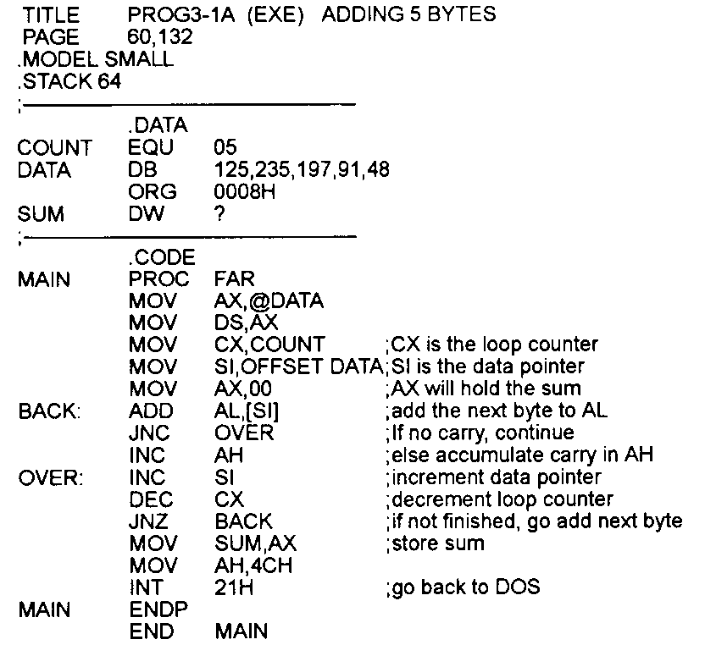
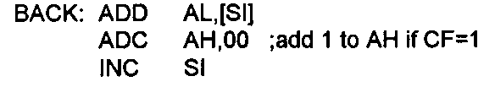
Addition Example of Individual Bytes
Draw the layout of the data segment in memory
What’s this for?

Slide 6
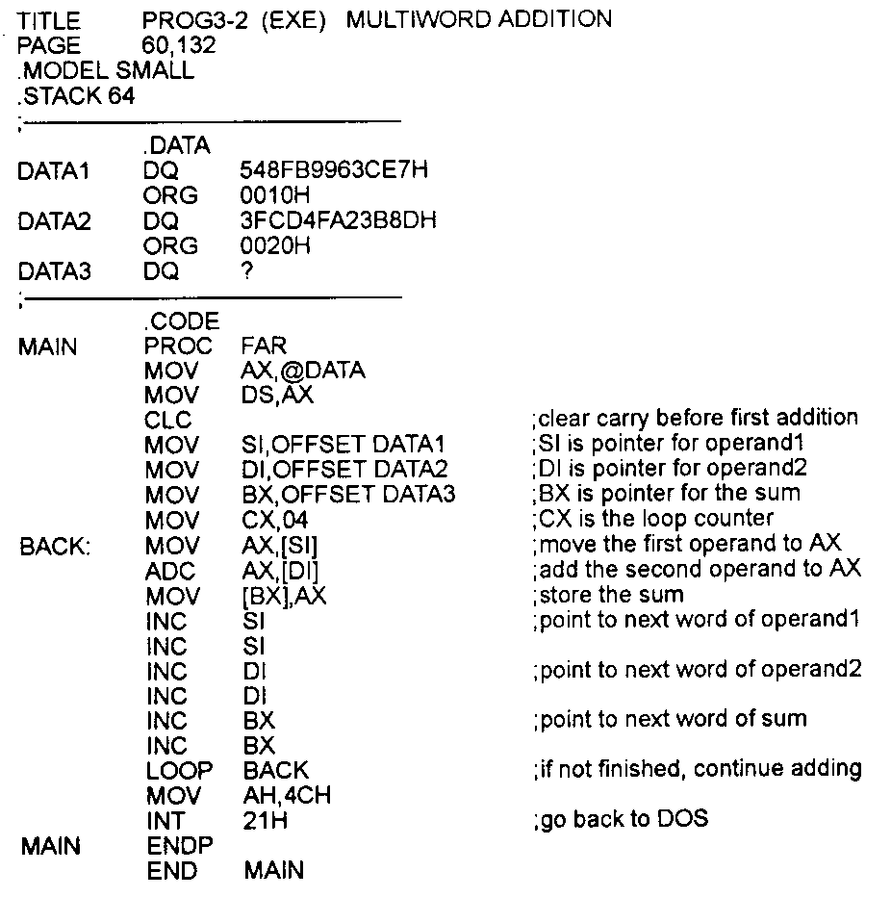
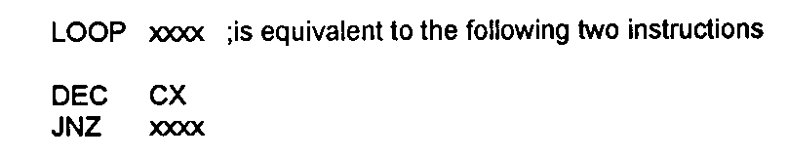
Addition Example of Multi-byte Nums

Slide 7
Unsigned Subtraction
SUB dest, src ;dest = dest - src
  Dest can be a register or in memory
  Src can be a register, in memory or an immediate
  No mem-to-mem operations in 80X86
  Change ZF, SF, AF, CF, OF, PF
SBB dest, src ;dest = dest - src – CF
  For multi-byte numbers
  If there is a borrow from last subtraction, subtracts 1 from the result

Slide 8
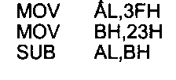

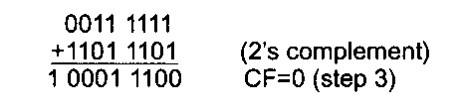


Subtraction Example of Individual Bytes
CPU carries out
  take the 2’s complement of the src
  add it to the dest
  invert the carry
CF = 0: positive result ;
CF = 1: negative result in 2’s complement
  Magnitude: NOT + INC

Slide 9
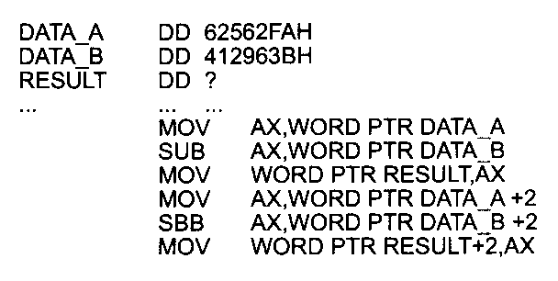



Subtraction Example of Multi-byte Nums

Slide 10
Unsigned Multiplication
MUL operand
byte X byte:
  One implicit operand is AL, the other is the operand, result is stored in AX
word X word:
  One implicit operand is AX, the other is the operand, result is stored in DX & AX
word X byte:
  AL hold the byte, AH = 0, the word is the operand, result is stored in DX & AX;

Slide 11
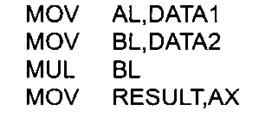
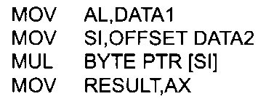
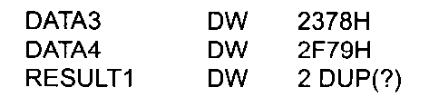
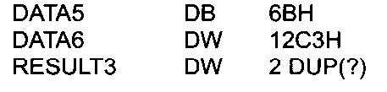
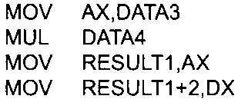
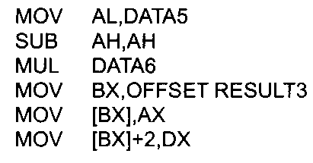
Unsigned Multiplication Example

Slide 12
Unsigned Division
DIV denominator
  Denominator cannot be zero
  Quotient cannot be too large for the assigned register
byte / byte:
  Numerator in AL, clear AH; quotient is in AL, remainder in AH
word / word:
  Numerator in AX, clear DX; ; quotient is in AX, remainder in DX
word / byte:
  Numerator in AX; quotient is in AL (max 0FFH), remainder in AH
double-word / word:
  Numerator in DX, AX; quotient is in AX (max 0FFFFH), remainder in DX
  Denominator can be in a register or in memory

Slide 13
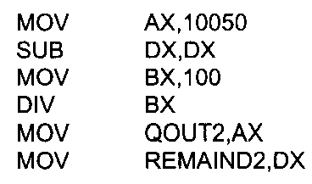
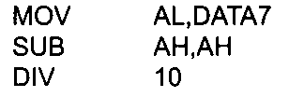
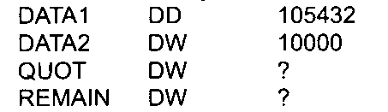
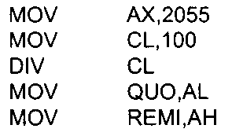
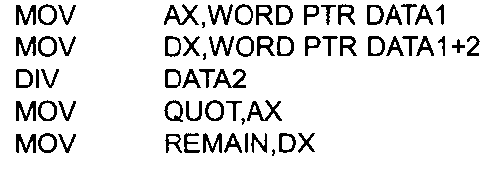
Unsigned Division Example

Slide 14
Logic Instructions
AND
OR
XOR
NOT
Logical SHIFT
ROTATE
COMPARE

Slide 15
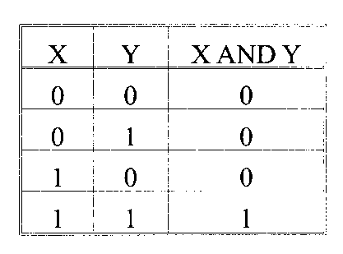
AND
AND dest, src
  Bit-wise logic
  dest can be a register, in memory

Slide 16
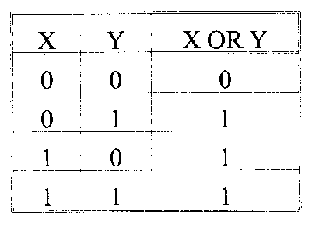
OR
OR dest, src
  Bit-wise logic
  dest can be a register, in memory

Slide 17
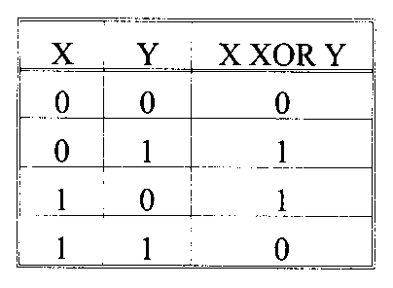
XOR
XOR dest, src
  Bit-wise logic
  dest can be a register, in memory

Slide 18
NOT
NOT operand
  Bit-wise logic
  dest can be a register or in memory
  X NOT X
  -------------------------------------------
  1 0
  0 1

Slide 19
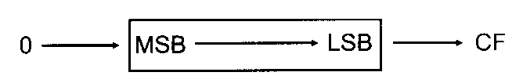
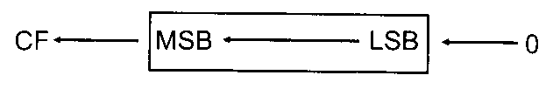
Logical SHIFT
SHR dest, times
  dest can be a register or in memory
  0->MSB->…->LSB->CF
  Times = 1:
  SHR xx, 1
  Times >1:
  MOV AL, times
  SHR xx, AL
SHL dest, times
  All the same except in reverse direction

Slide 20
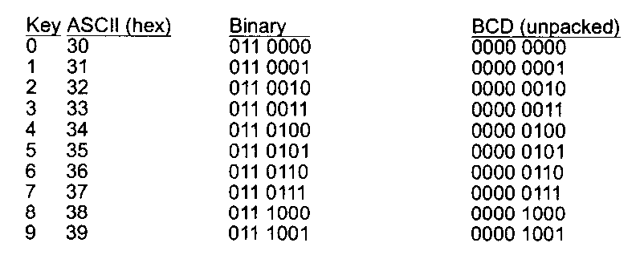
Example: BCD & ASCII Numbers Conversion
BCD: Binary Coded Decimal
  Digits 0~9 in binary representation
  Unpacked, packed
ASCII
  Code for all characters that you can read or write
  Digit characters ‘0’~’9’

Slide 21
ASCII -> Unpacked BCD Conversion
Simply remove the higher 4 bits “0011”
E.g.,
asc DB ‘3’
unpack DB ?
-------------------------
MOV AH, asc
AND AH, 0Fh
MOV unpack, AH

Slide 22
ASCII -> Packed BCD Conversion
First convert ASCII to unpacked BCD
Then, combine two unpacked into one packed
E.g., asc DB ‘23’
unpack DB ?
-------------------------
MOV AH, asc
MOV AL, asc+1
AND AX, 0F0Fh
MOV CL, 4
SHL AH, CL
OR AH, AL
MOV unpack, AH

Slide 23
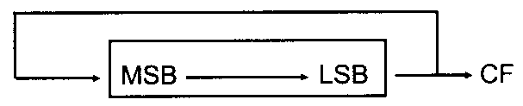
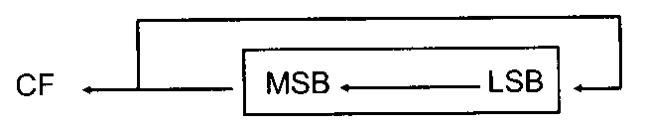
ROTATE
ROR dest, times
  dest can be a register, in memory
  Times = 1:
  ROR xx, 1
  Times >1:
  MOV AL, times
  ROR xx, AL
ROL dest, times
  All the same except in reverse direction

Slide 24
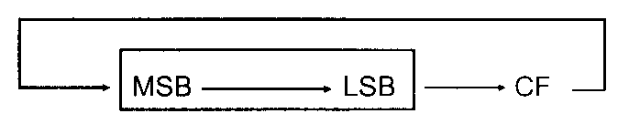
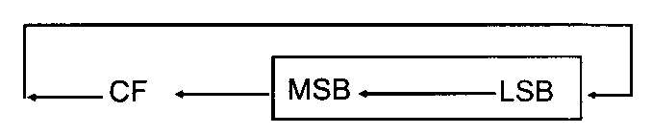
ROTATE Cont.
RCR dest, times
  dest can be a register, in memory
  Times = 1:
  RCR xx, 1
  Times >1:
  MCV AL, times
  RCR xx, AL
RCL dest, times
  All the same except in reverse direction

Slide 25
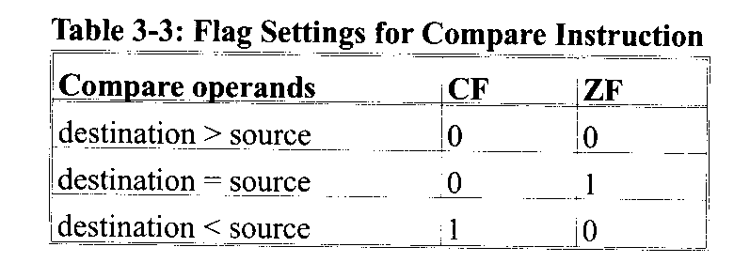
COMPARE of Unsigned Numbers
CMP dest, src
  Flags affected as (dest – src)
  E.g., CMP AL, 23
  JA lable1 ; jump if above, CF = ZF = 0

Slide 26
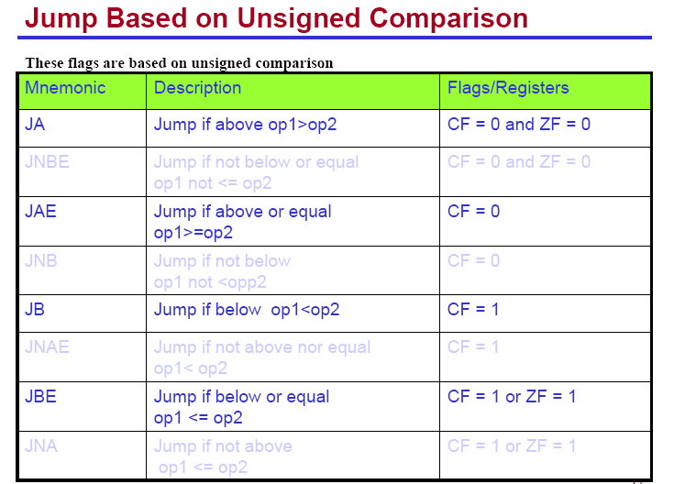

Slide 27
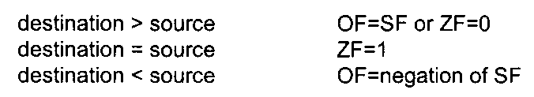
COMPARE of Signed Numbers
CMP dest, src
  Same instruction as the unsigned case
  but different understanding about the numbers and therefore different flags checked

Slide 28
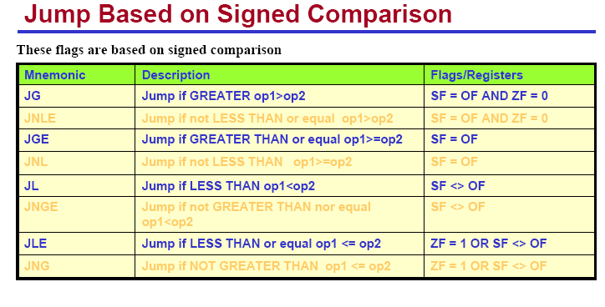

Slide 29
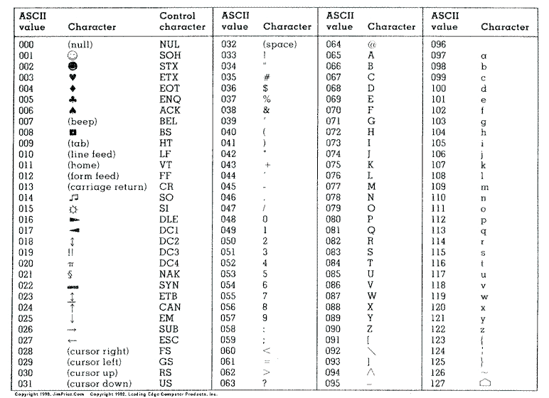
Quiz
Given the ASCII table, write an algorithm to convert uppercase letters into lowercase letters and implement your algorithm using 86 assembly language

